Slide 1
Object Cloning
Rajasekaran S
Assistant Professor,
Department of Information Technology,
KGiSL Institute of Technology,
email: proffraja@gmail.com
Github:www.github.com/rajasekaranap

Slide 2
Object Cloning
Object Cloning is creating exact copy of object.
The class must implement Cloneable Interface to make clone able objects.
clone() is method that used to clone the object.

Slide 3
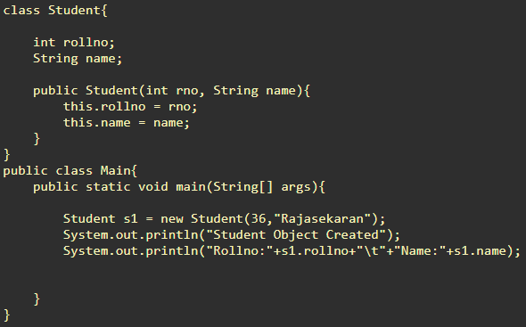

Object Copying
http://www.cyber-dojo.org/review/show/TVHTEEVeGC?avatar=hummingbird&was_tag=1&now_tag=1&filename=undefined

Slide 4
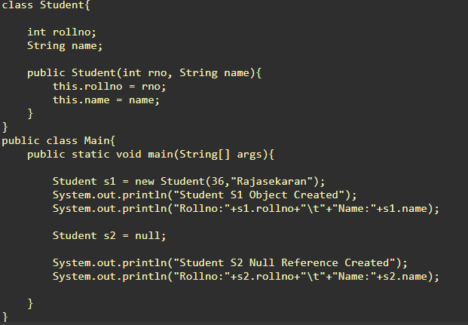
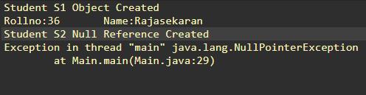
Null Object
http://www.cyber-dojo.org/review/show/TVHTEEVeGC?avatar=hummingbird&was_tag=4&now_tag=4&filename=output

Slide 5
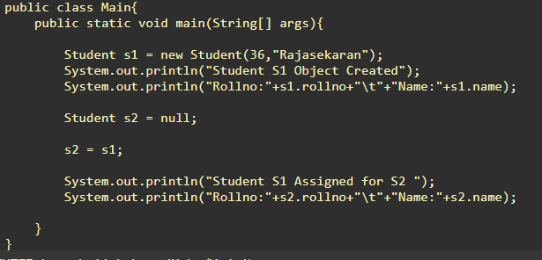
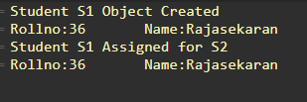
Reference Assignment
http://www.cyber-dojo.org/review/show/TVHTEEVeGC?avatar=hummingbird&was_tag=5&now_tag=5&filename=output

Slide 6
Assignment vs Clone
Copying is an operation to create identical copy not just reference.
S1
S1
rollno = 12
Name = “Rajasekaran”
rollno = 12
Name = “Rajasekaran”
rollno = 12
Name = “Rajasekaran”
S2
S2
s2 = s1
Clonning

Slide 7
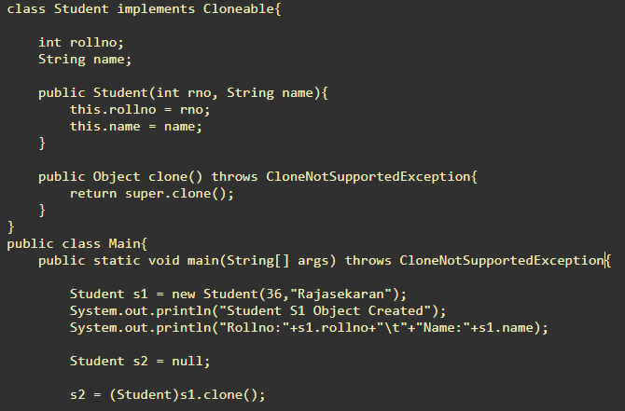
In Code
Cloneable Interface
Clone Method Over Raided
Clone Created
http://www.cyber-dojo.org/review/show/TVHTEEVeGC?avatar=hummingbird&was_tag=11&now_tag=12&filename=undefined

Slide 8
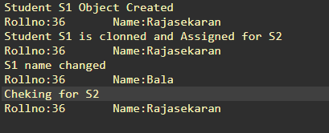
Output

Slide 9
Types of Clonning
Shallow Copy
Primitives copied but reference not copied.
Deep Copy
Creates full copy with all new reference
http://www.cyber-dojo.org/review/show/TVHTEEVeGC?avatar=hummingbird&was_tag=20&now_tag=21&filename=Main.java

Slide 10
Thank You
Rajasekaran S
Assistant Professor,
Department of Information Technology,
KGiSL Institute of Technology,
email: proffraja@gmail.com
Github:www.github.com/rajasekaranap

